Slide 1

Student Performance Prediction System
Machine Learning Project
Submitted by:
2520030563 - Siri Manasa
2520030046 - Pavani

Slide 2
INTRODUCTION
Student academic performance can be analyzed using factors such as attendance, study hours, and academic records.
Early analysis of student data helps identify academic patterns and areas that may need improvement.
The Student Performance Prediction System uses Machine Learning to predict student performance based on the available student data.
The system provides EDA charts to visualize academic trends and uses a web dashboard to display predictions.
It also stores prediction history in an SQLite database for future reference.

Slide 3
ABSTRACT
The Student Performance Prediction System is a Machine Learning-based application for analyzing and predicting student academic performance.
It uses student academic data to identify patterns and trends. Exploratory Data Analysis (EDA) visualizes CGPA distribution and the relationship between attendance, study hours, and academic performance.
A trained Machine Learning model generates predictions based on available student data.
The React.js dashboard displays predictions and EDA charts, while FastAPI handles backend requests.
SQLite stores prediction history for future reference.
The system aims to simplify academic analysis and support data-driven educational decisions.
INPUT
↓
ML MODEL
↓
PERFORMANCE

Slide 4
Problem Statement
PROBLEM STATEMENT
Analyzing student academic performance manually can be time-consuming.
Identifying patterns in student data and understanding performance trends can be challenging.
There is a need to analyze factors such as attendance, study hours, and CGPA.
Traditional analysis may not provide quick, data-driven performance predictions.
Therefore, a Machine Learning-based system is needed to predict student performance, visualize academic trends, and maintain prediction history.
.
.

Slide 5
Solution
Develop a Machine Learning-based system to predict student academic performance using available student data.
Perform Exploratory Data Analysis (EDA) to identify academic patterns and trends.
Use a trained ML model to generate predictions from student inputs.
Develop an interactive React.js dashboard to display predictions and visualizations.
Use FastAPI to process requests and connect the frontend with the ML model.
Integrate SQLite to store and retrieve prediction history.
Provide useful academic insights to support data-driven decision-making.

Slide 6
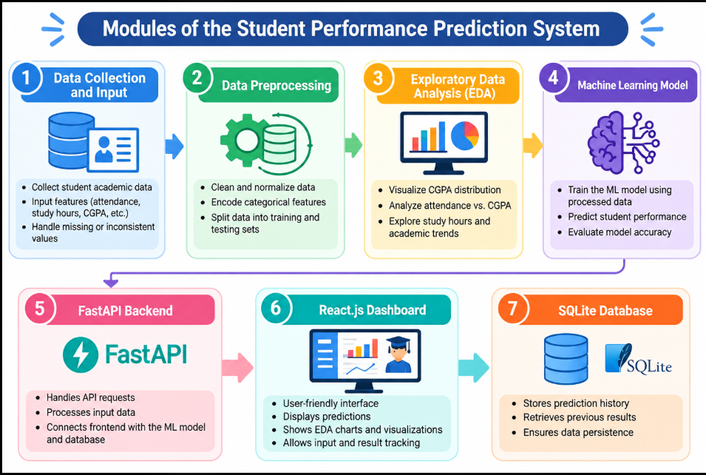

Slide 7
conclusion
Developed a Machine Learning-based system to predict student academic performance.
Used EDA to analyze student data and visualize academic trends.
Integrated a React.js dashboard with a FastAPI backend.
Used SQLite to store and retrieve prediction history.
The system simplifies academic data analysis and supports data-driven educational decisions.
Future improvements can include model optimization and personalized recommendations for students.

Slide 8
THANK YOU!
Student Performance Prediction System
Machine Learning Project

